Slide 1

Farming efficiency evaluation
Kasem Kunasri, MSc
Institute for Environmental Economics and World Trade
Leibniz University Hannover

Slide 2
Outlines
Introduction farming efficiency
Data extraction and preparation
Final dataset
How to estimate farming efficiency

Slide 3
Introduction farming efficiency
Farming efficiency assesses the economic performance of a farm under resource constraints.
It helps understand how efficiently farms utilize available inputs to achieve optimal production.
There are two important components in farm efficiency analysis (Hoang & Nguyen, 2019)
1) Measuring efficiency scores
Estimates the efficiency level of farms and identifies variations across different farms.
2) Identifying determinants of efficiency:
Analyzes factors influencing efficiency to provide practical recommendations for farmers and policymakers.
Helps in identifying strategies to improve efficiency and optimize resource use.

Slide 4
Introduction farming efficiency
Efficiency measurement approaches
Technical Efficiency: How well farms convert inputs into outputs.
Example: A farm using precision farming technology can maximize crop yield with minimal input waste.
Allocative Efficiency: The ability to use inputs at the lowest cost.
Example: A farmer selecting cost-effective fertilizers and irrigation methods to maximize profit margins.
Economic Efficiency: Combination of technical and allocative efficiency.
Example: A farm adopting mechanized plowing and strategic crop rotation to increase both yield and profitability.

Slide 5
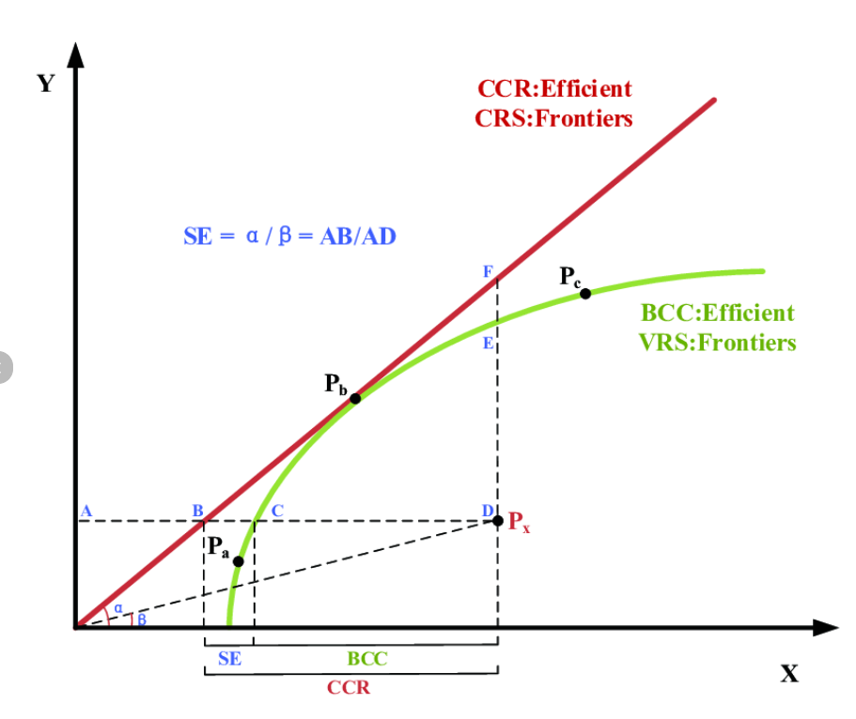
Introduction farming efficiency
There are two common methods for measuring farming efficiency
1) Data Envelopment Analysis (DEA):
DEA is a non-parametric method that compares the efficiency scores of farms without assuming a specific functional form .
It constructs an efficient frontier based on the best-performing farms and measures how far others deviate from this optimal efficiency.
Example: If a farm uses more inputs than another farm producing the same output, DEA identifies it as less efficient.

Slide 6
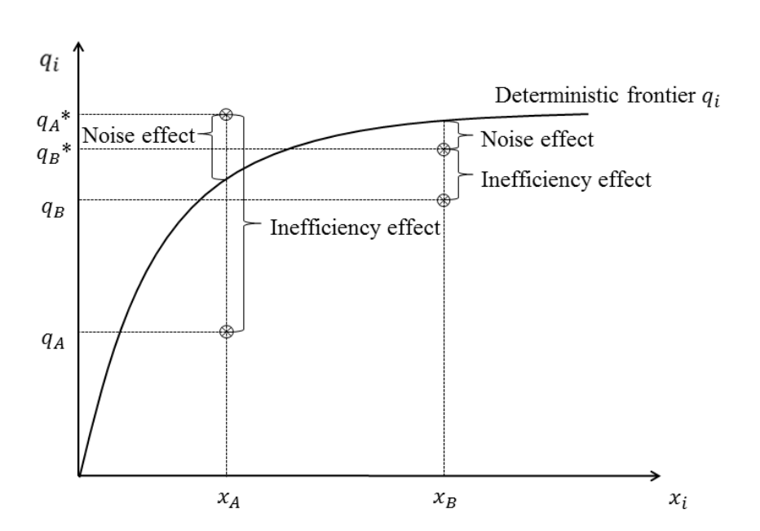
Introduction farming efficiency
Stochastic Frontier Analysis (SFA):
Definition: A parametric approach that assumes a specific production function and considers random errors that may affect farm output.
How it works: SFA separates inefficiency effects from random shocks (e.g., weather, pests) that can impact production.
Example: A farm may have lower output due to drought, not inefficiency—SFA helps distinguish these effects
The stochastic frontier model for efficiency analysis
(source: coelli et al., 2005)

Slide 7
Introduction farming efficiency
Comparison:
Aspect | DEA | SFA
Type | Non-parametric | Parametric
Error Consideration | No error term | Separates inefficiency & randomness
Best For | Benchmarking farms | Analyzing farm efficiency under uncertainty
Flexibility | No assumption on production function | Requires specifying a functional form
Conclusion
DEA is useful for benchmarking farms and identifying the best-performing ones.
SFA is preferred when considering external shocks that affect efficiency.

Slide 8


Introduction farming efficiency
Types of Production Functions in Efficiency Analysis:
Cobb-Douglas Production Function:
Translog Production Function:
CES (Constant Elasticity of Substitution) Production Function:
(1)
(2)
(3)

Slide 9
Introduction farming efficiency
Production Function | Key Characteristics | Use Cases
Cobb-Douglas | Assumes constant elasticity of substitution among inputs; commonly used in agricultural efficiency studies. | Analyzing returns to scale and input contributions in agriculture.
Translog | More flexible than Cobb-Douglas; allows for variable elasticities of substitution. | Suitable when input interactions need explicit modeling.
CES (Constant Elasticity of Substitution) | Allows for different degrees of input substitutability. | Used in technology adoption and efficiency studies.

Slide 10
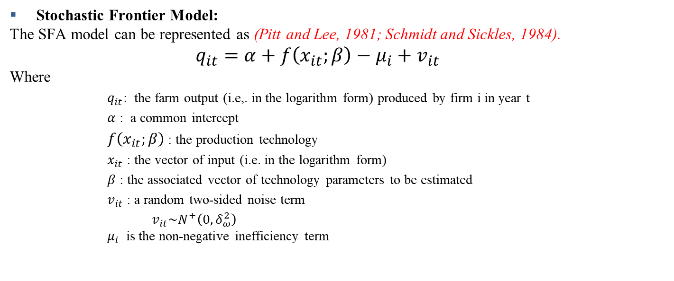
Introduction farming efficiency
Stochastic Frontier Model:
The SFA model can be represented as (Pitt and Lee, 1981; Schmidt and Sickles, 1984).
$q_{it}=α+f\left(x_{it};β\right)−μ_{i}+v_{it}$
Where
$q_{it}$: the farm output (i.e,. in the logarithm form) produced by firm i in year t
$α$ : a common intercept
$f\left(x_{it};β\right)$ : the production technology
$x_{it}$ : the vector of input (i.e. in the logarithm form)
$β$ : the associated vector of technology parameters to be estimated
$v_{it}$ : a random two-sided noise term
$v_{it}\sim N^{+}\left({0, δ}_{ω}^{2}\right)$ $μ_{i}$ is the non-negative inefficiency term
(4)

Slide 11
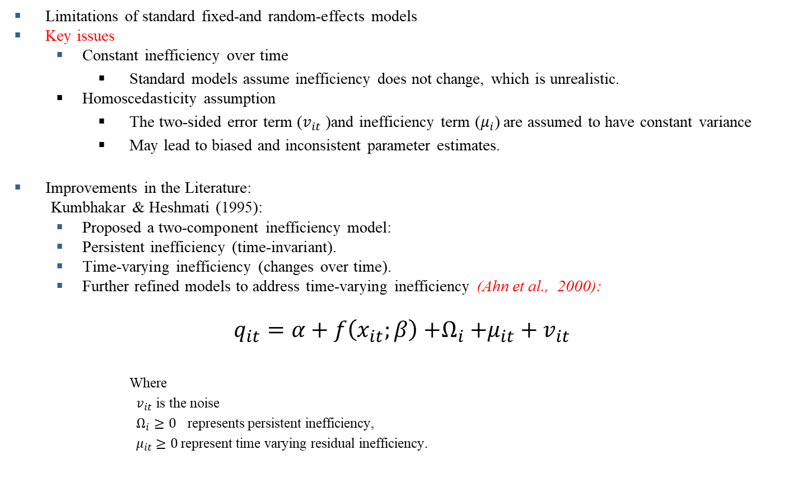
Introduction farming efficiency
Limitations of standard fixed-and random-effects models
Key issues
Constant inefficiency over time
Standard models assume inefficiency does not change, which is unrealistic.
Homoscedasticity assumption
The two-sided error term ($v_{it}$ )and inefficiency term ($μ_{i}$) are assumed to have constant variance
May lead to biased and inconsistent parameter estimates.
Improvements in the Literature:
Kumbhakar & Heshmati (1995):
Proposed a two-component inefficiency model:
Persistent inefficiency (time-invariant).
Time-varying inefficiency (changes over time).
Further refined models to address time-varying inefficiency (Ahn et al., 2000):
$$q_{it}=α+f\left(x_{it};β\right){+Ω}_{i}+μ_{it}+v_{it}$$
Where
$v_{it}$ is the noise
$Ω_{i}≥0$ represents persistent inefficiency,
${ μ}_{it}$ $≥0$represent time varying residual inefficiency.
(5)

Slide 12
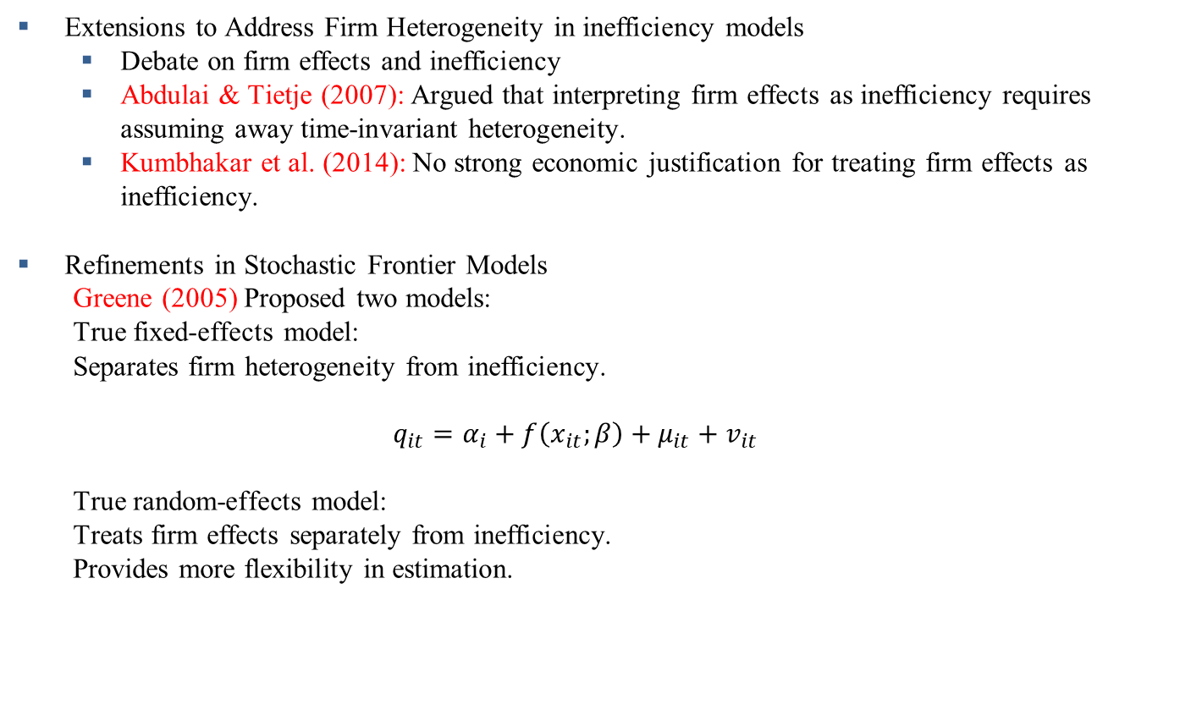
Introduction farming efficiency
Extensions to Address Firm Heterogeneity in inefficiency models
Debate on firm effects and inefficiency
Abdulai & Tietje (2007): Argued that interpreting firm effects as inefficiency requires assuming away time-invariant heterogeneity.
Kumbhakar et al. (2014): No strong economic justification for treating firm effects as inefficiency.
Refinements in Stochastic Frontier Models
Greene (2005) Proposed two models:
True fixed-effects model:
Separates firm heterogeneity from inefficiency.
$$q_{it}=α_{i}+f\left(x_{it};β\right)+μ_{it}+v_{it}$$
True random-effects model:
Treats firm effects separately from inefficiency.
Provides more flexibility in estimation.
(6)

Slide 13

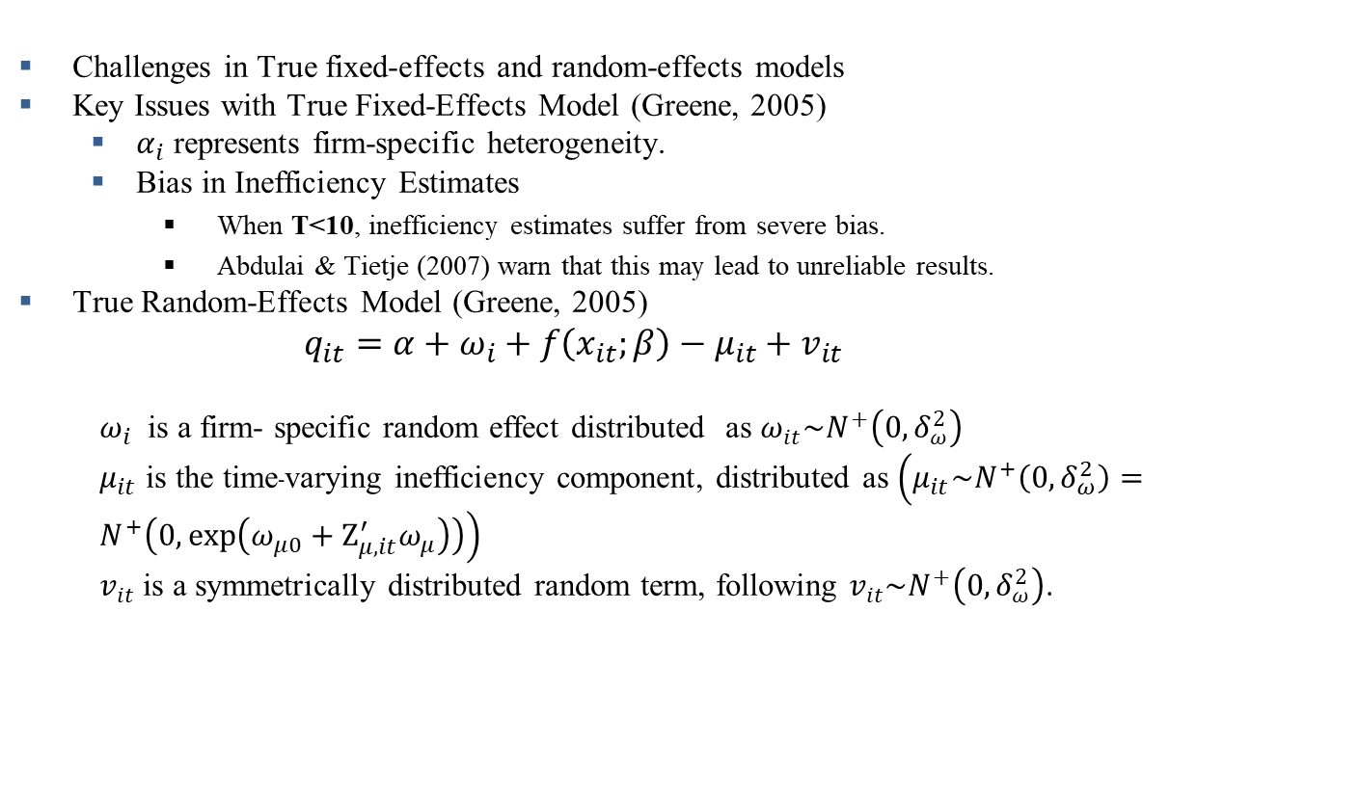
Introduction farming efficiency
$$q_{it}=α_{i}+f\left(x_{it};β\right)+μ_{it}+v_{it}$$
(6)
Challenges in True fixed-effects and random-effects models
Key Issues with True Fixed-Effects Model (Greene, 2005)
$α_{i}$ represents firm-specific heterogeneity.
Bias in Inefficiency Estimates
When T<10, inefficiency estimates suffer from severe bias.
Abdulai & Tietje (2007) warn that this may lead to unreliable results.
True Random-Effects Model (Greene, 2005)
$$q_{it}=α+ω_{i}+f\left(x_{it};β\right)−μ_{it}+v_{it}$$
$ω_{i}$ is a firm- specific random effect distributed as $ω_{it}\sim N^{+}\left({0, δ}_{ω}^{2}\right)$
$μ_{it}$ is the time-varying inefficiency component, distributed as $\left(μ_{it}\sim N^{+}\left({0, δ}_{ω}^{2}\right)=N^{+}\left(0,\exp\left(ω_{μ0}+Ζ_{μ,it}^{′}ω_{μ}\right)\right)\right)$
$v_{it}$ is a symmetrically distributed random term, following $v_{it}\sim N^{+}\left({0, δ}_{ω}^{2}\right)$.
(7)

Slide 14
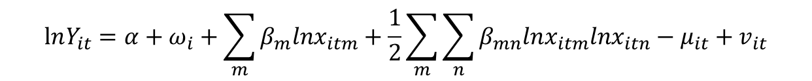
Introduction farming efficiency
So, We follow the translog specification from Nguyen et al., (2021) that can be written as:
$$lnY_{it}=α+ω_{i}+\sum_{m}{β_{m}lnx_{itm}+\frac{1}{2}}\sum_{m}{\sum_{n}{β_{mn}lnx_{itm}lnx_{itn}−μ_{it}+v_{it}}}$$
Translog Functional Form for Efficiency Analysis
Why Translog?
More flexible than the Cobb-Douglas functional form.
Allows for elasticity of substitution between inputs.
Frequently used in stochastic frontier models.
Notes:
Key Takeaways
✔ True random-effects models effectively separate inefficiency from firm heterogeneity. ✔ Translog functional form provides greater flexibility in efficiency estimation. ✔ Maximum likelihood estimation improves estimation accuracy.

Slide 15
Data extraction and coding
Variables | Data file | Variable at the household level
Y: Output_crop_value | crop_hh | _x42034
X1: Land_cultivated | crop_hh | _x42005
X2: Labor_farm | mem_hh | _x21014
X3: Cost_labor_hired | crop_hh | x42021 + _x42019 +_x42024 +_x42026 + _x42028
X4:Cost_seed | crop_hh | _x42020
X5: Cost_weeding | crop_hh | _x42022
X6: Cost_land_prep | crop_hh | _x42018
X7: Cost_fertilizer | crop_hh | _x42023
X8: Cost_pesticides | crop_hh | _x42025
X9: Cost_harvest | crop_hh | _x42027
X10: Cost_irrigation | crop_hh | _x42029

Slide 16
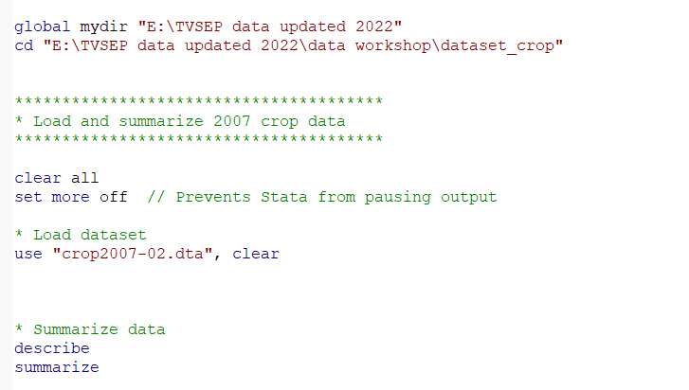
Data Extraction and Preparation
Step 1: Data Preparation and Loading
Load the first dataset into Stata
Open the Stata do-file: gen_variables.do
Set the directory and load crop data for 2007-2017
Can follow the do file named gen_variables

Slide 17
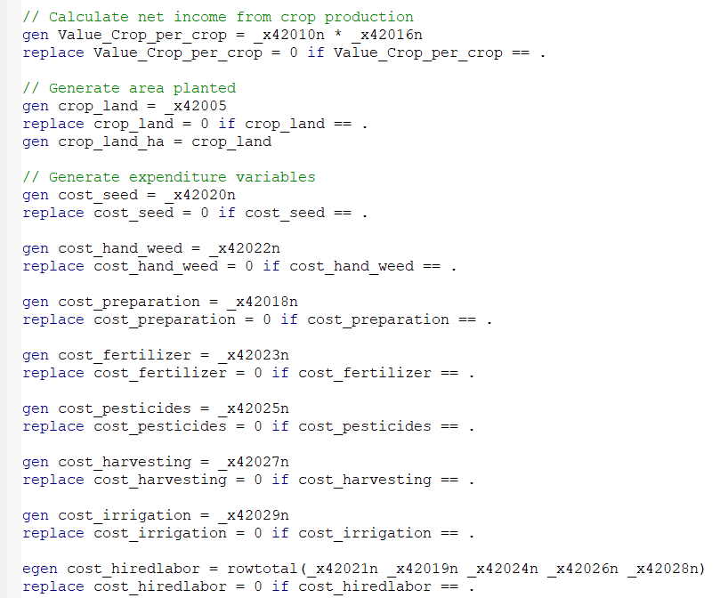
Data extraction and coding
Step 2: Generating key variables
Defining key farming variables in Stata
Can follow the do file named
gen_variables

Slide 18
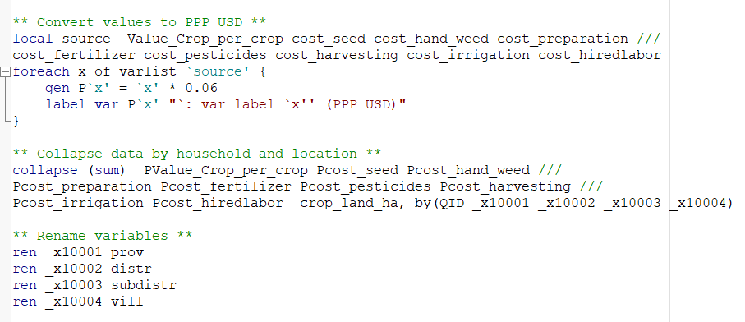
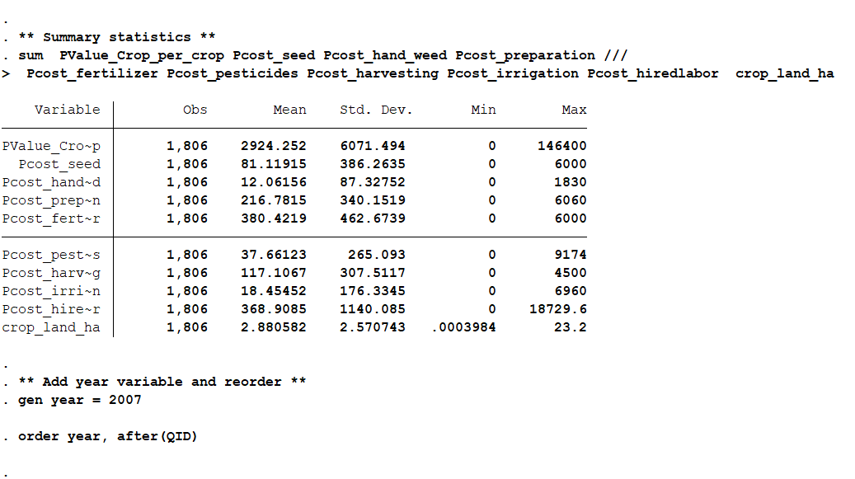
Data extraction and coding
Step 3: Converting and aggregating data
Standardizing financial values
Convert financial variables to Purchasing Power Parity (PPP) USD for better comparability.
Why PPP Conversion?
PPP accounts for differences in price levels across regions.
Ensures financial figures are internationally comparable.
Aggregating Data at Household and Location Level
Summarize financial and land-use data at the household level
Why Collapse Data?
Aggregates data from individual crops to household-level values.
Reduces redundancy for analysis.

Slide 19
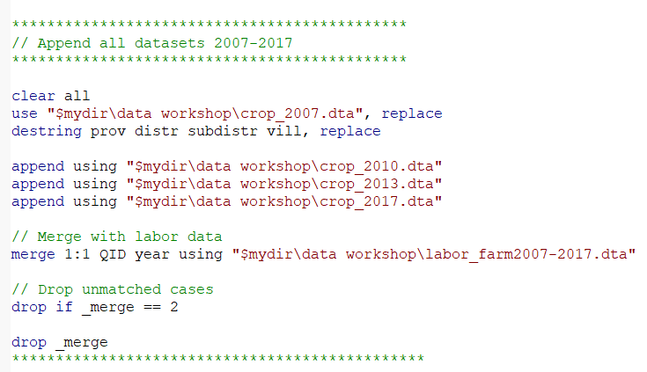
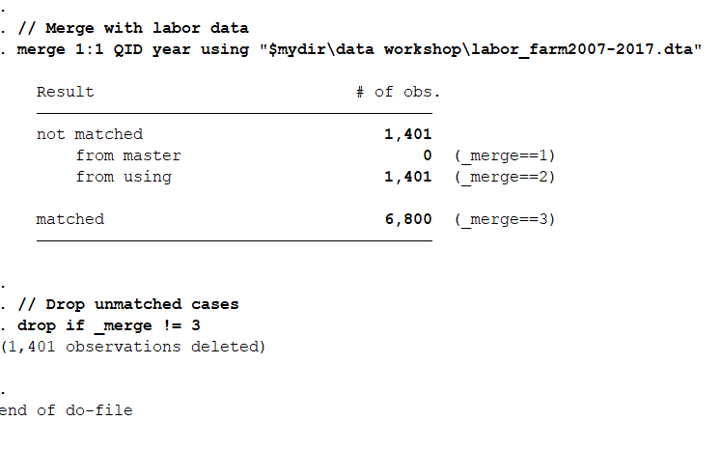
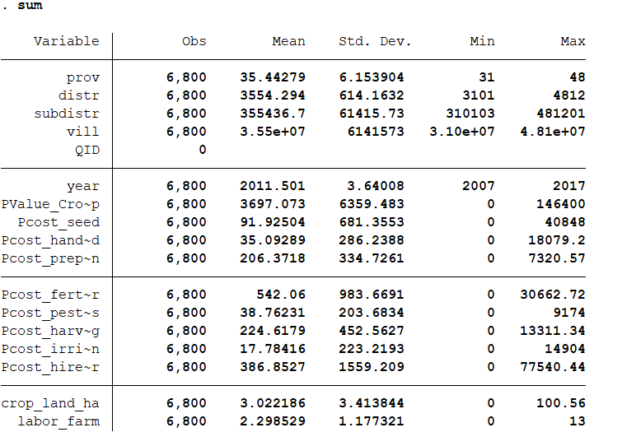
Data extraction and coding
Step 4 : make panel data set
Combining Multiple Years of Data
append using “…….”
Merging: one-to-one
Merge 1:1 QID year using…..

Slide 20
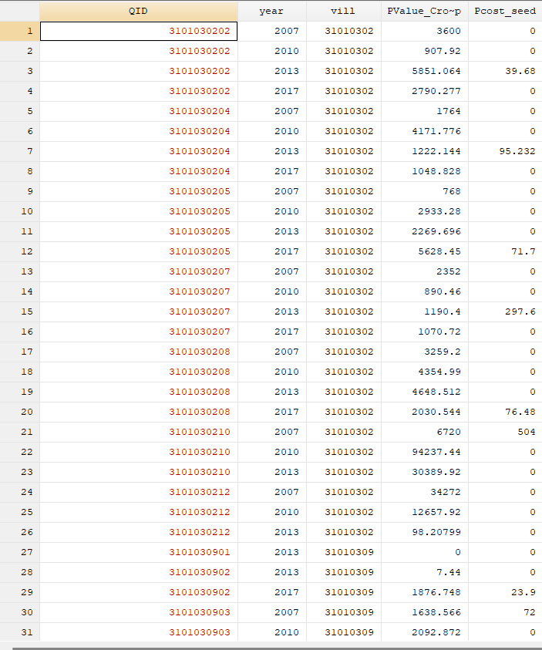
Final dataset
Step 5: log-transforming variables
Clear all
use "final_dataset2007-2017.dta" ,clear
sort QID year
Why log transformation?
Helps normalize skewed data for better statistical analysis.
Reduces the impact of outliers
Allows interpretation in terms of elasticities in regression models.

Slide 21
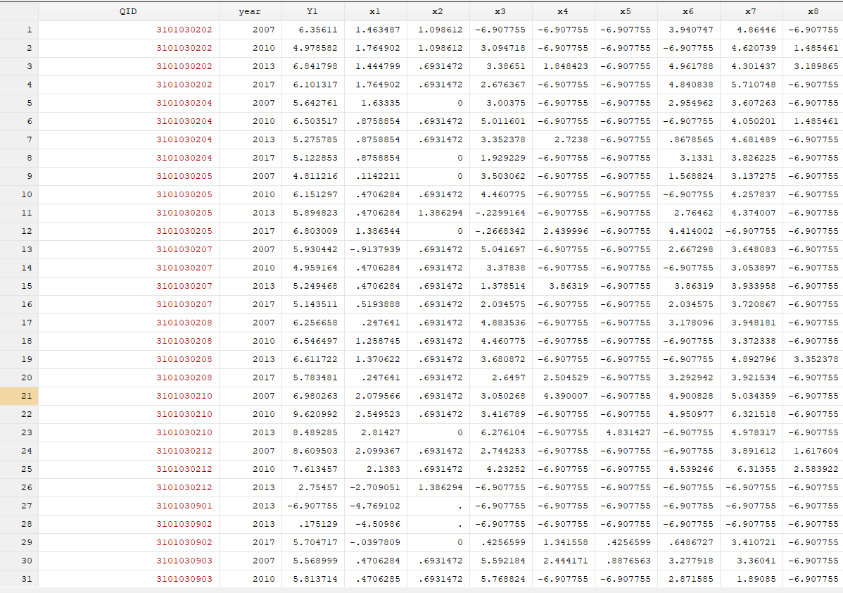
Final dataset
Step 6: Preparing the Final Dataset for Analysis
Key Transformations Applied
Standardization: Converted all cost and revenue variables to per hectare (Ha) basis.
Log Transformations: Applied logarithmic transformation to key variables to improve statistical properties.
Code
local source PValue_Crop_per ….
foreach x of varlist `source' {
replace `x' = `x' * 0.16
lab var `x' "`: var lab `x''(PPP USD/Ha)"
}
*
// Generating log-transformed variables for production function
gen Y1 = ln(PValue_Crop_per_crop + 0.001) // Log of crop output value
gen x1 = ln(crop_land_ha + 0.001) // Log of land cultivated
gen x2 = ln(labor_farm) // Log of farm labor
gen x3 = ln(Pcost_hiredlabor + 0.001) // Log of hired labor cost
gen x4 = ln(Pcost_seed + 0.001) // Log of seed cost
gen x5 = ln(Pcost_hand_weed + 0.001) // Log of weeding cost
gen x6 = ln(Pcost_preparation + 0.001) // Log of land preparation cost
gen x7 = ln(Pcost_fertilizer + 0.001) // Log of fertilizer cost
gen x8 = ln(Pcost_pesticides + 0.001) // Log of pesticide cost
gen x9 = ln(Pcost_harvesting + 0.001) // Log of harvest cost
gen x10 = ln(Pcost_irrigation + 0.001) // Log of irrigation cost

Slide 22
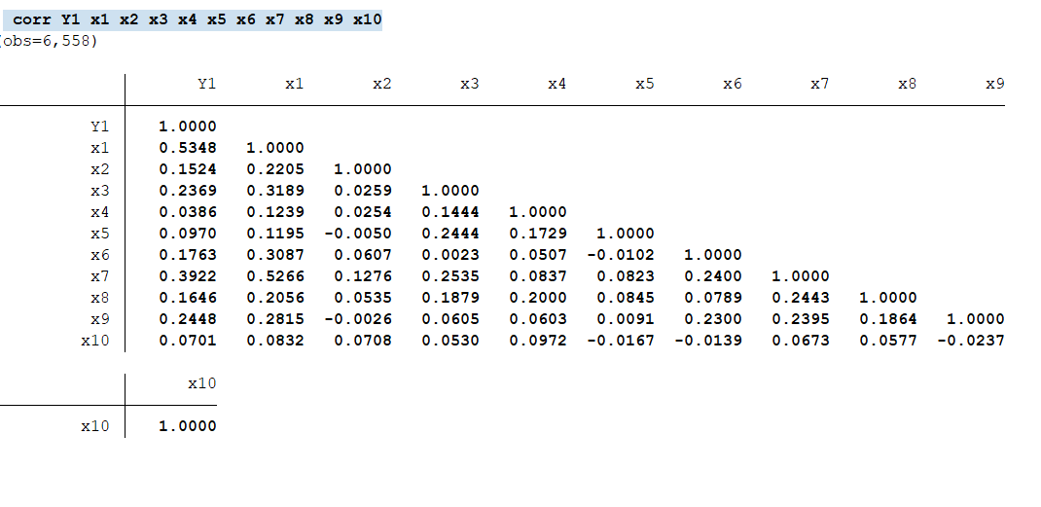
Final dataset
Step 7 : Correlation test
Correlate (corr) - displays the correlation matrix or covariance matrix for a group of variables. It measure the direction and strength of linear relationship between two quantitative variables
Values range from -1 to 1:
1 → Perfect positive correlation
0 → No correlation
-1 → Perfect negative correlation

Slide 23
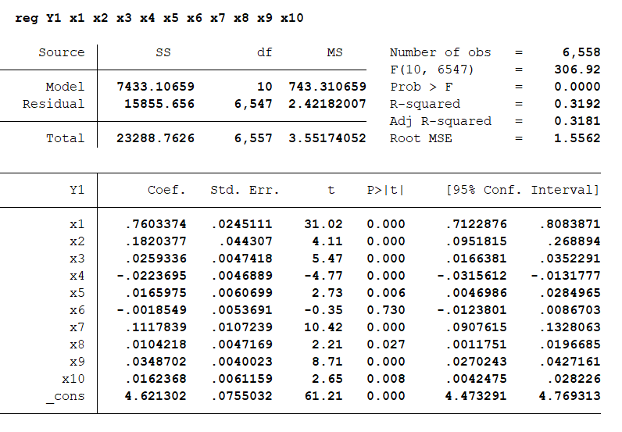
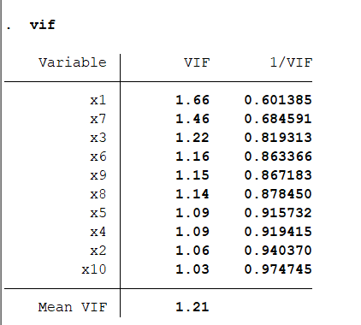
Final dataset
Step 8 : Multicollinearity check (VIF)
1) Running the Regression Model
2. Checking for Multicollinearity (VIF Analysis)
Rule of Thumb:
VIF > 10 → High multicollinearity issue (needs attention).
VIF 5-10 → Moderate multicollinearity.
VIF < 5 → Low or no concern.
Findings:
Mean VIF = 1.21 → No serious multicollinearity concerns.
Highest VIF is for x1 (1.66), which is well below the threshold of 5.

Slide 24
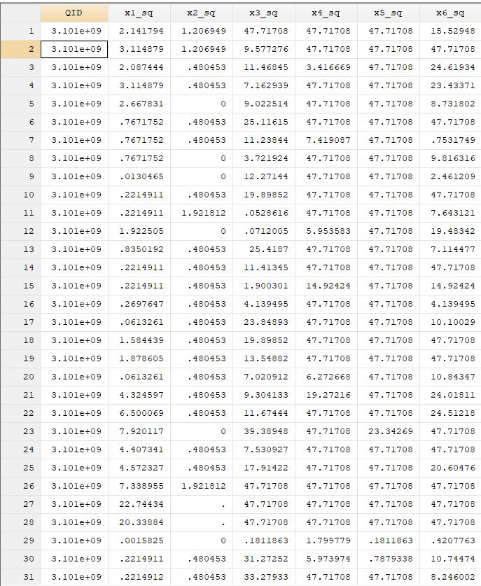
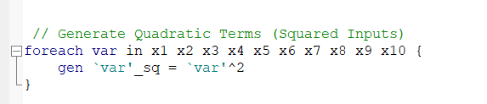
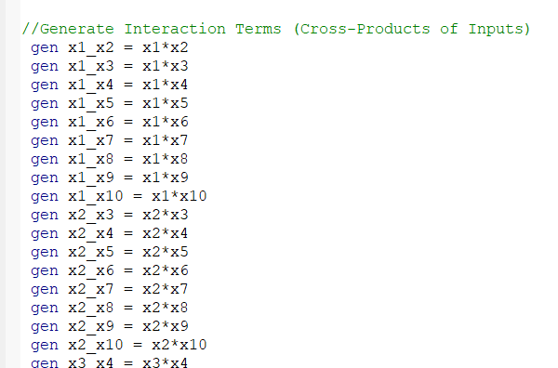
How to estimate farming efficiency
// Generate Quadratic Terms (Squared Inputs)
// Generate Interaction Terms (Cross-Products of Inputs)

Slide 25
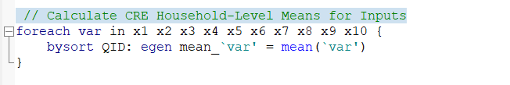
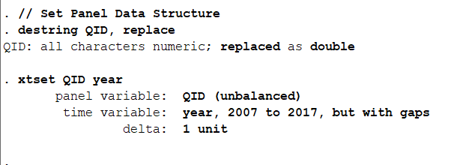

How to estimate farming efficiency
// Calculate CRE household-level means for inputs
// Set panel data structure

Slide 26
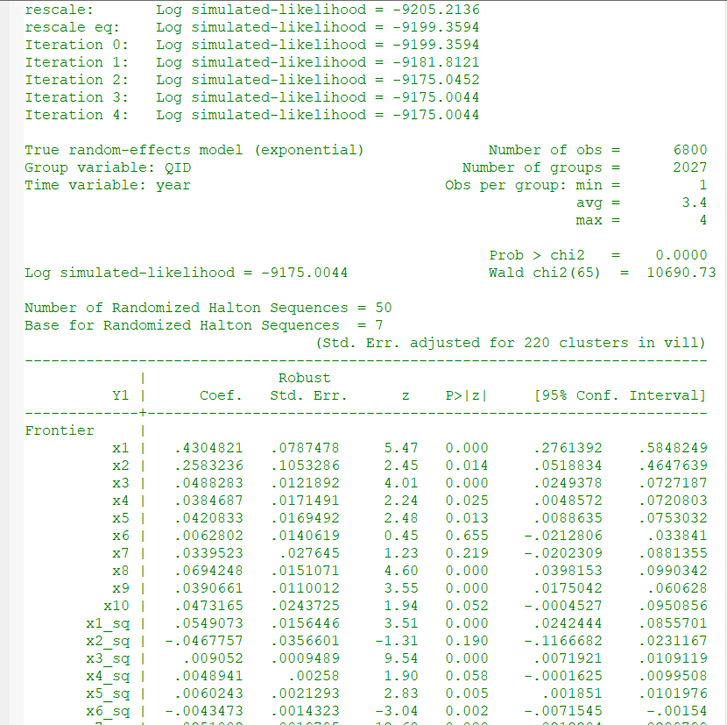
How to estimate farming efficiency
(1) Translog stochastic frontier production estimation from the true random-effects model
//sfpanel → Stochastic Frontier Panel Data Estimation.
//Y1 → Log-transformed output (dependent variable).
//x1, x2, ..., x10 → Main inputs.
//x1_sq, x2_sq, ..., x10_sq → Quadratic terms (capture non-linearity).
//x1_x2, ..., x9_x10 → Interaction terms (capture complementarities).
//model(tre) → Time-varying random effects (TRE) model.
//rescale base(7) → Rescales inefficiency estimates.
//simtype(genhalton) nsim(50) → Uses Halton sequences with 50 simulations.
//difficult → Helps when convergence is challenging.
//cluster(vill) → Adjusts standard errors at the village level. //

Slide 27
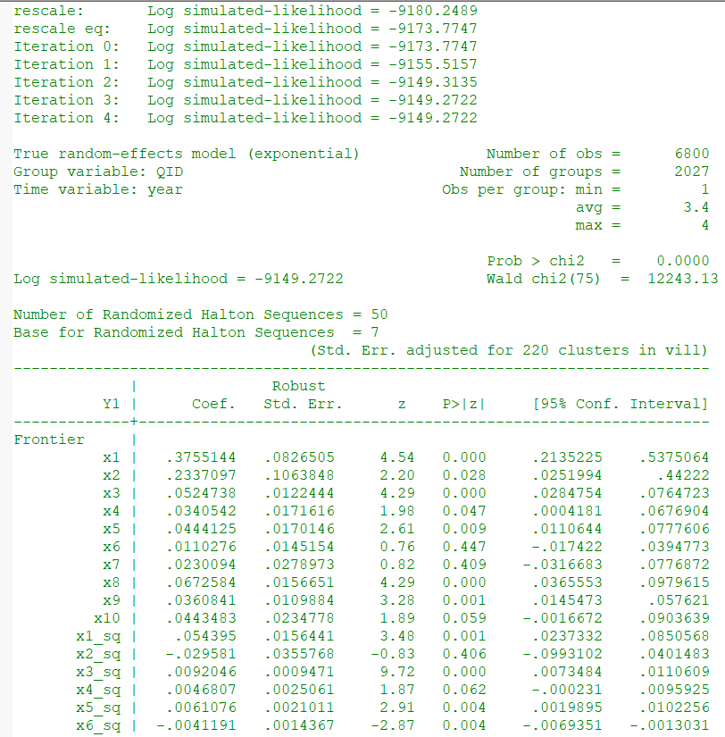
How to estimate farming efficiency
(2) Translog stochastic frontier production estimation from the true random-effects model with Mundlak’s adjustments (CRE)
//sfpanel → Stochastic frontier panel data estimation.
Option are the same (1)
Add mean_x1, ..., mean_x10 → Household-level means

Slide 28
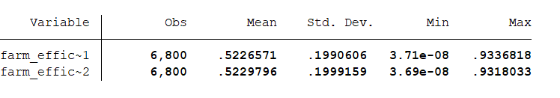
How to estimate farming efficiency
Predict score farming efficiency

Slide 29
References
Abdulai, A. and Tietje, H. (2007). Estimating technical efficiency under unobserved het- erogeneity with stochastic frontier models: application to northern German dairy farms. European Review ofAgricultural Economics 34: 393–416.
Ahn, S., Good, D. and Sickles, R. (2000). Estimation of long-run inefficiency levels: a dynamic frontier approach. Econometric Reviews 19: 461–492.
Coelli, T. J., Rao, D. S. P., O'Donnell, C. J., & Battese, G. E. (2005).An Introduction to Efficiency and Productivity Analysis (2nd ed.). Springer.
Greene, W. (2005). Reconsidering heterogeneity in panel data estimators of the stochastic frontier model. Journal ofEconometrics 126: 269–303.
Huy, H. T., & Nguyen, T. T. (2019). Cropland rental market and farm technical efficiency in rural Vietnam. Land Use Policy, 81, 408–423.
Kumbhakar, S. C. and Heshmati, A. (1995). Efficiency measurement in Swedish dairy farms: an application of rotating panel data, 1976–88. American Journal ofAgricultural Economics 77: 660–674
Kumbhakar, S. C., Lien, G. and Hardaker, J. B. (2014). Technical efficiency in competing panel data models: a study ofNorwegian grain farming. Journal ofProductivity Analysis 41: 321–337.
Nguyen, T. T., Tran, V. T., Nguyen, T. T., & Grote, U. (2021). Farming efficiency, cropland rental market and income effect: Evidence from panel data for rural Central Vietnam. European Review of Agricultural Economics, 48(1), 207–248.
Pitt, M. M. and Lee, L. F. (1981). The measurement and sources of technical inefficiency in the Indonesian weaving industry. Journal ofDevelopment Economics 9: 43–64.
Schmidt, P. and Sickles, R. (1984). Production frontiers and panel data. Journal ofBusiness and Economic Statistics 2: 367–374.

Slide 30



